Slide 1
Resume Ranker
Automating Smarter Hiring with NLP & Microservices

Slide 2

The Problem
Recruiters are overwhelmed.
Hundreds of resumes per role
Manual filtering is slow and error-prone
Good candidates often get overlooked

Slide 3
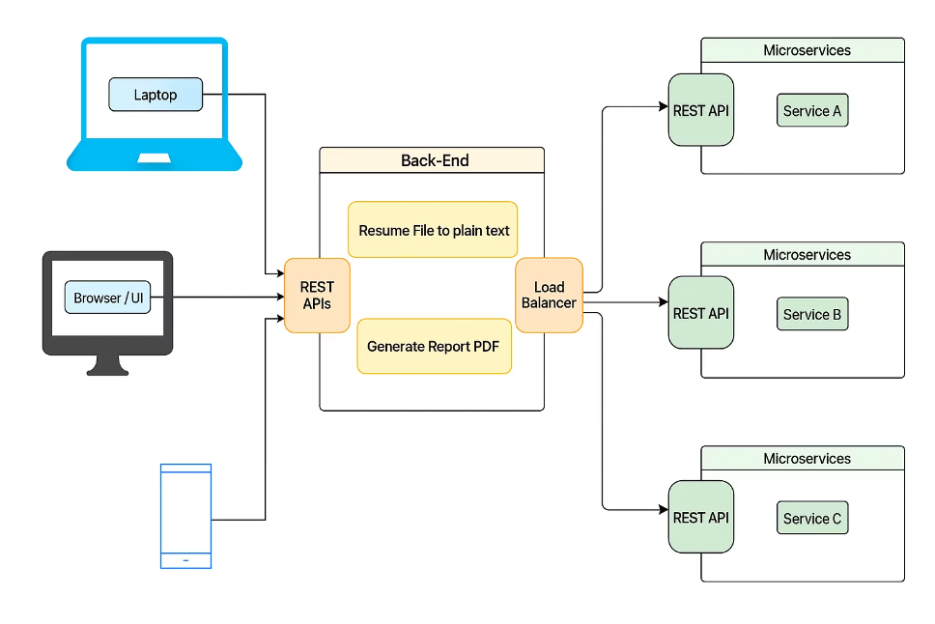
The Solution — Resume Ranker
An NLP-powered system that:
Analyzes resumes against job descriptions
Ranks candidates by match score
Flags missing skills, format issues
Provides actionable feedback

Slide 4
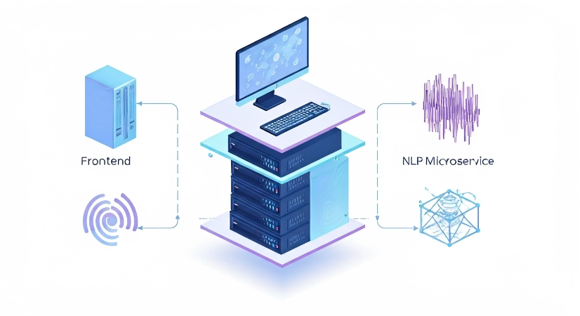
Architecture Overview
Three-Layer Architecture:
Frontend — Collects input & displays results
Backend — Handles requests & orchestrates logic
NLP Microservice — Analyzes resumes using spaCy

Slide 5
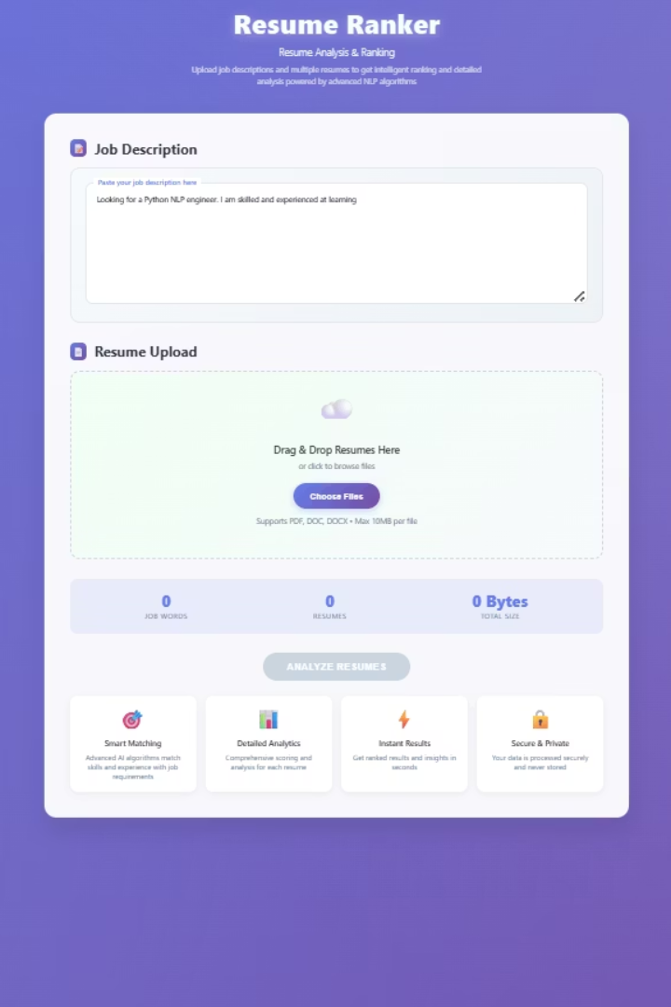
Frontend Layer
Built With: HTML, CSS, JavaScript (Vanilla JS)
Accepts up to multiple resumes at once
Sends data via fetch() to backend
Displays results dynamically

Slide 6

Backend Layer
Built With: Node.js + Express.js
Accepts & validates input
Forwards to Python microservice using Axios
Supports file upload via Multer
Converts files using Mammoth & pdf-parse
Generates reports via Puppeteer or pdfkit

Slide 7

NLP Microservice Layer
Built With: Python + Flask + spaCy
Computes Match Score (Jaccard + spaCy vectors)
Extracts keywords, named entities
Detects formatting issues
Suggests resume improvements

Slide 8
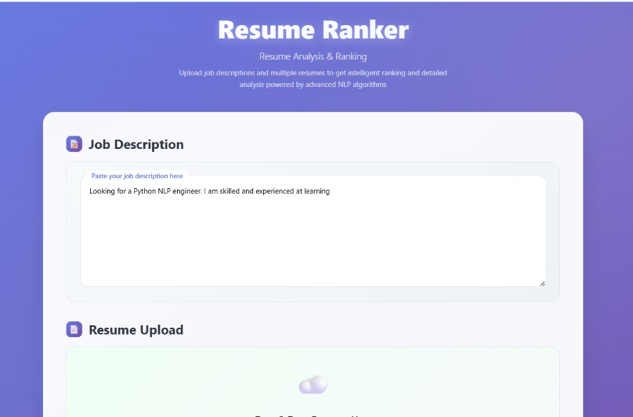
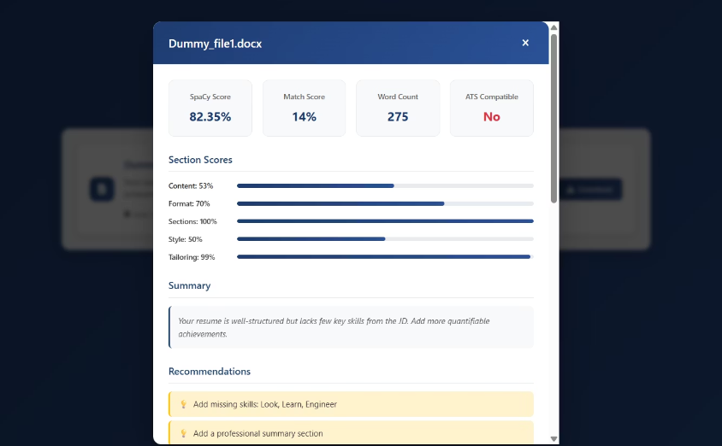
Basic Demo

Slide 9

Initial Challenge: Some Resumes Took 1-2 Seconds
Resume parsing time varied significantly
Slowed down bulk analysis
50–100+ resumes take 150s - 200s
Caused by:
Cold starts in NLP containers
Uneven load distribution

Slide 10

Optimizing Performance
Solution
Result
Architected the NLP as a scalable microservice
Reduced average parsing time to under 500ms per resume
Increased the number of service instances to distribute load more evenly
Achieved 4x speed improvement
Implemented process limits to control throttling and prevent overload

Slide 11
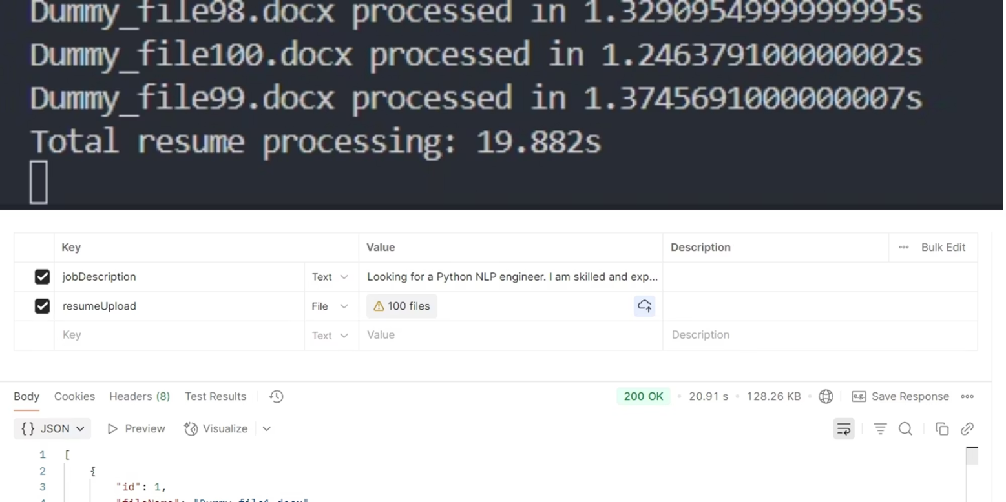
Result Achieved

Slide 12

Real-World Impact
Saves recruiter time
Improves candidate shortlisting accuracy
Provides personalized resume feedback
Scalable and production-ready

Slide 13
Future Scope
GPT-powered feedback
Multilingual support
Integration with job portals
Auto-reply to shortlisted candidates

Slide 14
Thank You
Questions?
Let's build smarter hiring, together.

